Slide 1

Lab 3a – Factory Method
Creational Design Pattern
INSPIRING CREATIVE AND INNOVATIVE MINDS

Slide 2
FACTORY METHOD (Class Creational)
Intent:
  Define an interface for creating an object, but let subclasses decide which class to instantiate.
  Factory Method lets a class defer instantiation to subclasses.
Motivation:
  Framework use abstract classes to define and maintain relationships between objects
  Framework has to create objects as well - must instantiate classes but only knows about abstract classes - which it cannot instantiate
  Factory method encapsulates knowledge of which subclass to create - moves this knowledge out of the framework

Slide 3
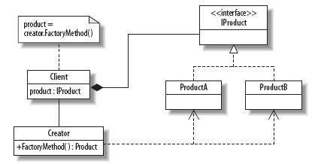
Structure

Slide 4
Participants
IProduct
  The interface for products
ProductA and ProductB
  Classes that implement IProduct
Creator
  Provides the FactoryMethod
FactoryMethod
  Decides which class to instantiate

Slide 5
Lab Exercise
Implementation and Example: Avocado Sourcing
  Write a simple program to apply Factory Method in the avocado sourcing
  Each of the avocado-producing countries has a class, and they all implement IProduct so that they can ship avocados to the buyer.
  Depending on the month, write the FactoryMethod that will choose to supply either ProductA (avocados from South Africa) or ProductB (avocados from Spain).
  There is also a third option, a DefaultProduct, which is selected when avocados are not available (in this case, in month 3).
  Code skeleton is available here

